Slide 1
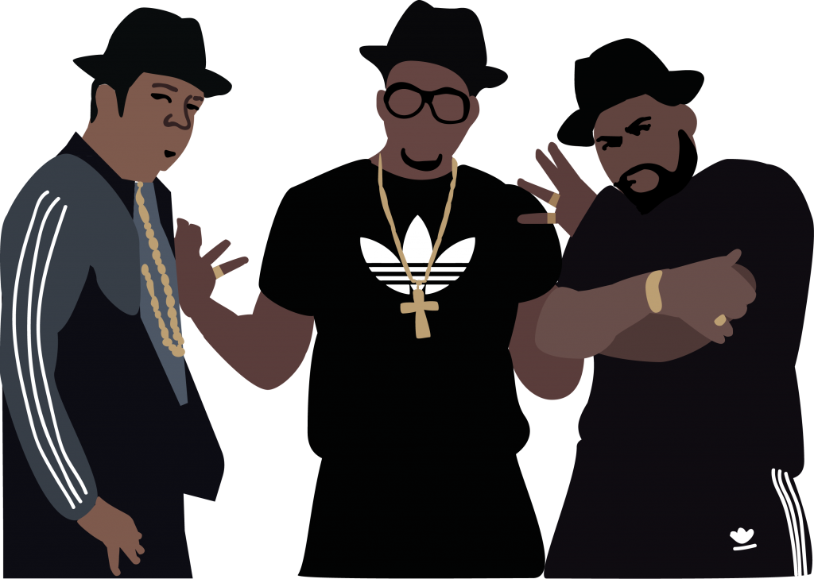
RHYTHM, RHYME AND RAP MUSIC

Slide 2
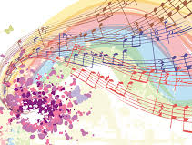
WHAT IS RHYTHM?
Rhythm is a beat.
It can be found in music and it is easily identified.

Slide 3
RAP MUSIC USES RHYTHM TO GREAT EFFECT
It has a flow to it that you can tap your foot in time to and not just because of beat of the music, but also because the words have got a beat (rhythm) too.

Slide 4
GOOD EXAMPLES OF SONGS THAT MAKE USE OF RHYTHM ARE...

Slide 5
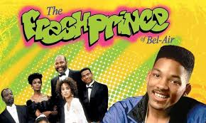

Slide 6
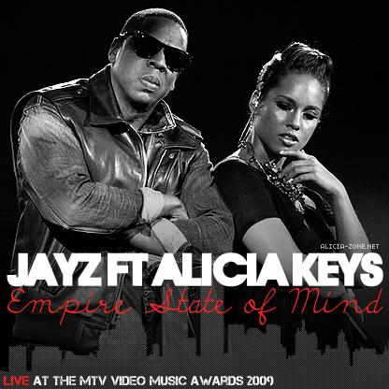

Slide 7
WHAT IS RHYME?
Rhyme is a repetition of sounds.
Rhyming often occurs at the end of a line, but it can also be found in the middle of a line. This is called INTERNAL RHYME.
For example:
"the cat and the bat went for a walk
They took a picnic and ate by the dock"

Slide 8
STRONG RHYME VS WEAK RHYME
Words can have strong rhymes, like
'slime' and 'chime"
They can also have weak rhymes, like 'heat' and 'heal'.

